Slide 1
The T in TDD
Tests, Types, Tales
Mathias / @brandewinder

Slide 2
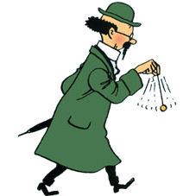
Who am I?
Mathias Brandewinder (@brandewinder)
C# for about 10 years
Fell in love with F# 5 years ago
Background: Economics, Operations Research
I do have a bit of an accent :)

Slide 3
Why this talk?
TDD had a deep impact on my coding habits
Since moving to F#, I barely use Red/Green/Refactor

Slide 4
What happened?
Perhaps TDD really is dead?
“doing TDD” differently?
How do I code in F#?

Slide 5

TDD by Example
Kent Beck

Slide 6
Money (classic version)

Slide 7
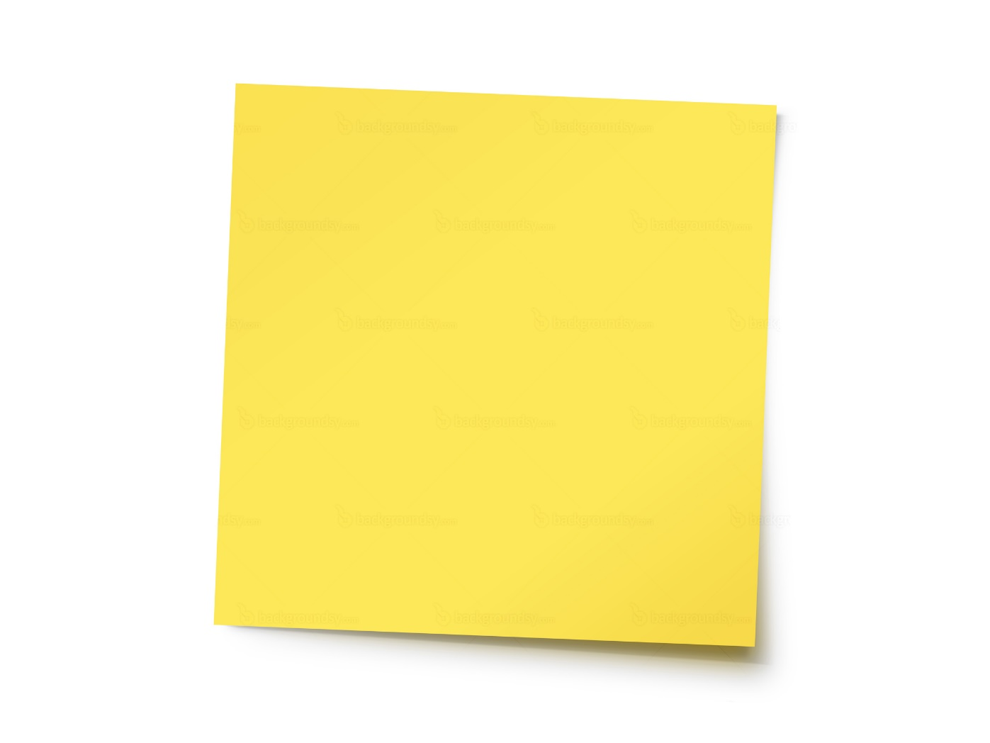
TODO
if CHF:USD is 2:1,
$5 + 10 CHF = $10
$5 * 2 = $10

Slide 9
What’s good about TDD?

Slide 10
Code without fear
TDD is a way of managing fear during programming. [...] If pain is nature’s way of saying “Stop!”, fear is nature’s way of saying “Be careful.” The problem is that fear has a host of other effects:
Makes you tentative
Makes you grumpy
Makes you want to communicate less
Makes you shy from feedback

Slide 11
Small, actual steps
Clear protocol
Break into small chunks

Slide 12
Craft your language
Define vocabulary
Make assumptions explicit
Clarify thinking & conversations

Slide 13
Experiment in code
Write runnable code
Rapid feedback
Surface questions & issues

Slide 14
Feel the pain
Makes bad design painful
Suffer early

Slide 15
Money (F# remix)

Slide 17
The D in TDD
Design, or Development?

Slide 18
Friction
Tests slow down early refactoring
“Premature abstraction”
Sane language defaults

Slide 19
Scripting as TDD
You must design organically, with running code providing feedback between decisions
You must write your own tests, since you can’t wait twenty times a day for someone else to write a test
Your development environment must provide rapid response to small changes
Your designs must consist of many highly cohesive, loosely coupled components, just to make testing easy

Slide 21
A unit test shows
one way
your code is not broken

Slide 22
A unit test is an anecdote

Slide 23
anecdote
ˈanɪkdəʊt/
noun
“a short amusing or interesting story about a real incident or person.”

Slide 24
Types
What don’t you test?
Fastest feedback: compile time
Replace a Test with a Type?
Property Based Test: triangulate

Slide 25
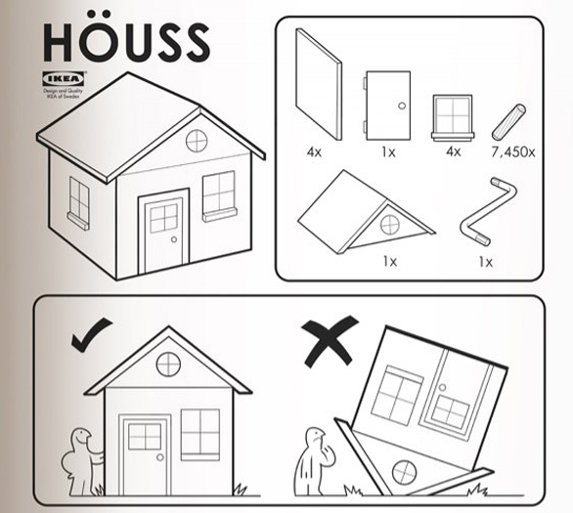
Tales
Source: www.lamakerspace.com

Slide 26
Literate Programming
The documentation…
… is the code

Slide 27
Living document
The truth is the code
Working software and comprehensive documentation
F# as a Ubiquitous Language

Slide 28
Conclusion

Slide 29
Happy with classic TDD? Cool.
Do write tests! (pretty please)

Slide 30
Don’t discard ideas wholesale
Do look at other paradigms

Slide 31
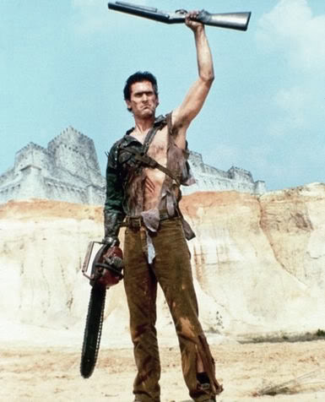
I'll give you my gun REPL
when you pry it
from my cold, dead hands

Slide 32

Thank you!
Mathias Brandewinder
@brandewinder
Brandewinder.com

